Slide 1
Vidhyadeep Institute of Management & Technology
ELECTRICAL DEPARTMENT
Hybrid Vehicles
Guided By Mr. Vicky Paperwala

Slide 2
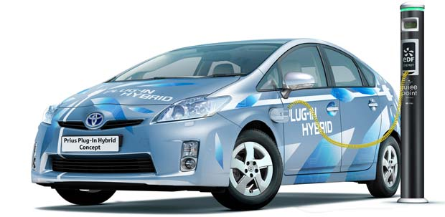
future of automotive
telematics
*Hybrid Vehicles*

Slide 3

there are many questions

Slide 4
What is a Hybrid Car????

Slide 5
What is a Hybrid Car????
Why was the hybrid car developed???

Slide 6
What is a Hybrid Car????
Why was the hybrid car developed???
How dose a Hybrid Car
Work ???

Slide 7
What is a Hybrid Car????
Why was the hybrid car developed???
How dose a Hybrid Car
Work ???
Who invented hybrid cars??? Ect...

Slide 8
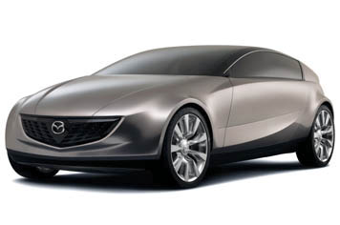
What is a Hybrid Car????
A hybrid vehicle is a vehicle that uses
two or more distinct power sources to
move the vehicle.^{[2]} The term most
commonly refers to hybrid electric
vehicles (HEVs), which combine an
internal combustion engine and one
or more electric motors. However
other mechanisms to capture and
utilize energy are included....

Slide 9
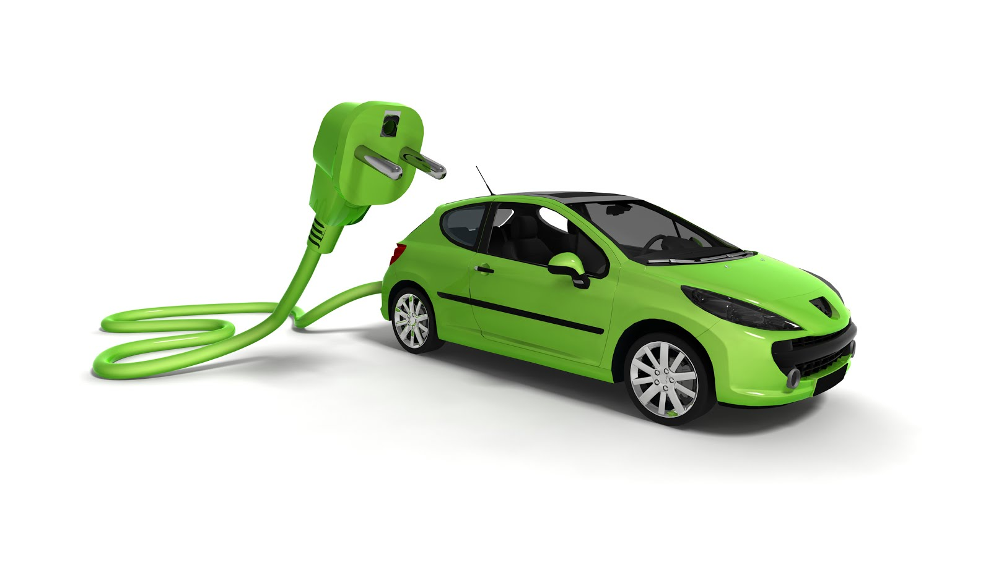
Why were the hybrid car developed???
Hybrids are better for the environment. They save oil and they save the environment tons of greenhouse gas. I guess they were invented for
people who wanted a cleaner Earth.

Slide 10

World energy shortage
and growing demand
have caused energy crises

Slide 11
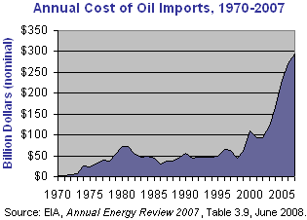
Why fuel efficiency is important???
World oil consumption, 2007
Rank | Country | Oil – consumption (bbl/day) | Date
1 | World | 85,220,000 | 2007 est.
2 | United States | 20,680,000 | 2007 est.
3 | European Union | 14,390,000 | 2007
4 | China | 7,880,000 | 2007 est.
5 | Japan | 5,007,000 | 2007 est.
6 | India | 2,722,000 | 2007 est.
7 | Russia | 2,699,000 | 2007 est.
8 | Germany | 2,456,000 | 2007 est.
9 | Brazil | 2,372,000 | 2007 est.
10 | Canada | 2,371,000 | 2007 est.
18 | Iran | 1,600,000 | 2007 est.
 | Rest of the world | 23,043,000 | 2007 est.
US
Source: www.cia.gov/library/publications/the-world-factbook

Slide 12
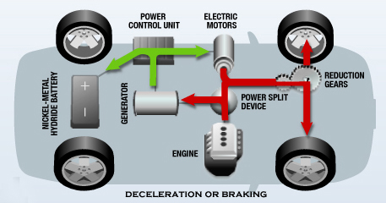
How dose a Hybrid Car Work ?
The basic concept of a hybrid car is to combine the most efficient power sources for the car. This should maximize fuel savings and minimize carbon emissions. Put simply, hybrid cars run on a combination of electricity and gas

Slide 13


Slide 14
Who invented hybrid cars?

Slide 15
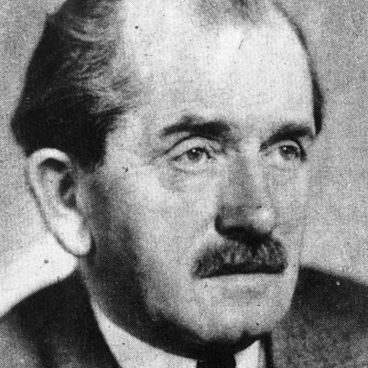
Who invented hybrid cars?
.
.

Slide 16
Who invented hybrid cars?
.
Ferdinand Porsche in 1899

Slide 17

Types by drive train
structure
Parallel hybrid
Series hybrid

Slide 18
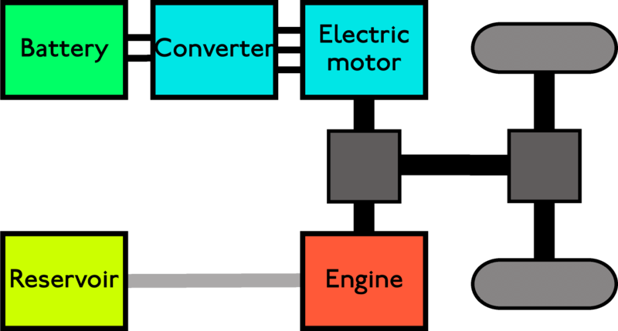
Parallel hybrid
Parallel hybrid systems, which are most commonly produced at present, have both an internal combustion engine (ICE) and an electric motor coupled. If they are joined at an axis in parallel, the speeds at this axis must be identical and the supplied torques add together. When only one of the two sources is being used, the other must either also rotate in an idling manner, be connected by a one-way clutch, or freewheel. With cars, the two sources may be applied to the same shaft- for example with the electric motor lying between the engine and transmission. The speeds are thus equal and the torques add up, with the electric motor adding or subtracting torque to the system as necessary.

Slide 19
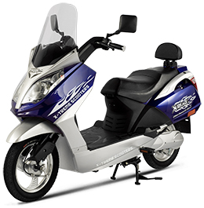
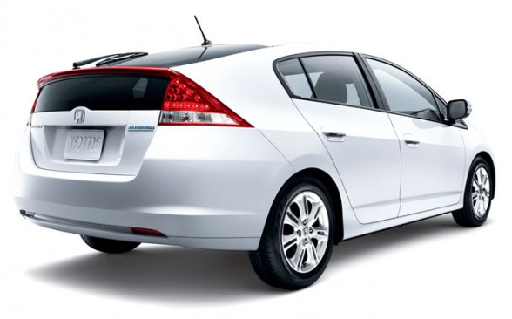
Most electric bicycles are of this type
The Honda Insight uses this system.

Slide 20
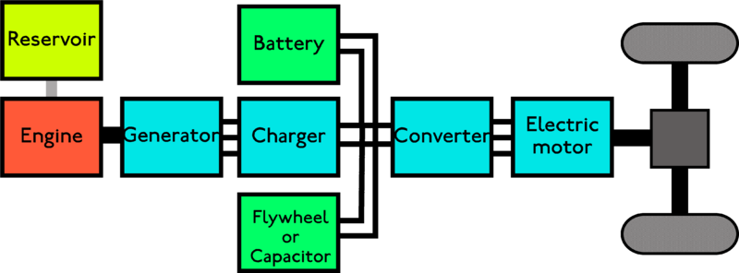
Series hybrid
Series hybrids have also been referred to as extended-range electric vehicles (EREV) or range-extended electric vehicles (REEV) where they are designed to be run mostly by the battery, but have a petrol or diesel generator to recharge the battery when going on a long drive. However, range extension can be accomplished with either series or parallel hybrid layouts. Alternatively, it can be viewed as an electric transmission, with the battery storing reserve power until it is needed.

Slide 21
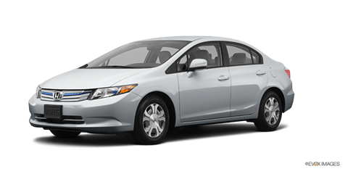
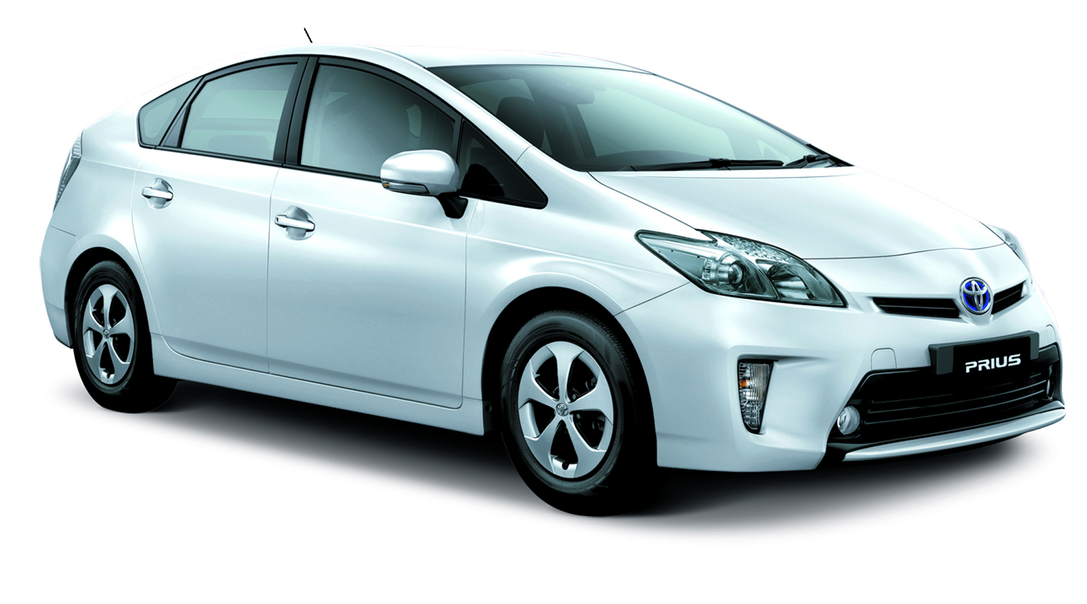
EXAMPLE
HONDA-CIVIC HYBRID
TOYOTA-PRIUS

Slide 22


Slide 23

Difference Between
Hybrid and Electric cars
HYBRID | ELECTRIC
Hybrid cars can be called a partially electric. They make use of a mixture of gas and electric power. | Electric cars totally depend on electricity, which means they are cent per cent electric. They have to get charged and the car moves till the charge lasts.
One main difference between the hybrid and electric cars is with regard to batteries
the batteries not only provide energy but also get recharged while driving. | the batteries of an electric car do not get recharged unless plugged to some source of energy.

Slide 24
advantages
• Compare the pollution levels caused by hybrids with that of petrol automobiles. You’ll know in a jiffy that the emissions gushing out of petrol vehicles are way higher than their hybrid counterparts.
• Hybrids draw lesser tax than the gasoline-powered automobiles.
• Introduction of hybrids will also reduce dependency on oil which is a fast-depleting natural oil resource.
• Though expensive to buy, hybrids don’t need fuel re-fills every now and then, thus saving the fuel expenditure.
• The mileage obtained is much better.

Slide 25
disadvantages
• These cars being expensive,
• Hybrid technology is fairly new and hasn’t been tested well. Only time can tell what obstacles may occur while driving.
• Hybrids are lighter than conventional cars, hence making them more prone to accidents. In case of a collision with regular gasoline automobiles, hybrids and their occupants suffer greater damage.
• Hybrids may be eco-friendly on the road, but produce twice the amount of pollution during the manufacturing process.
• The accelerative power is relatively low.
• Winters or cold weather can influence the working of batteries, thus hampering the hybrid’s performance.

Slide 26
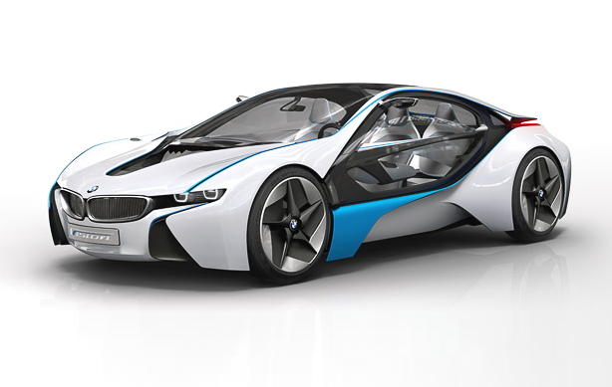
Sume upcaming cars
&concept

Slide 27
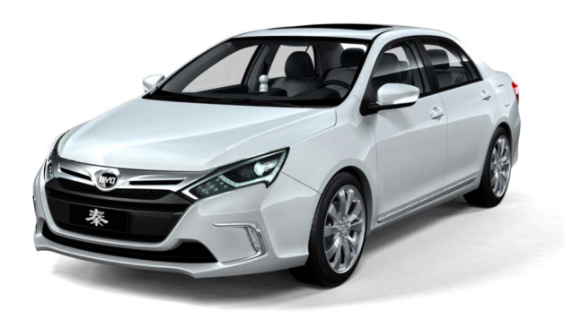
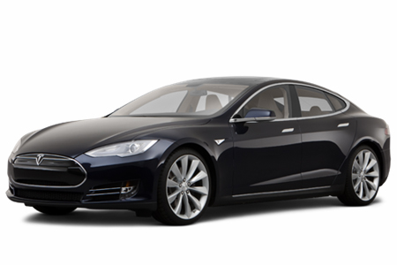
BYD-E9
TESLA

Slide 28


FORD-FUSION
BMW ActiveHybrid 3

Slide 29

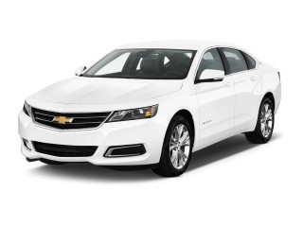
Acura ILX
chevrolet impala 2014

Slide 30
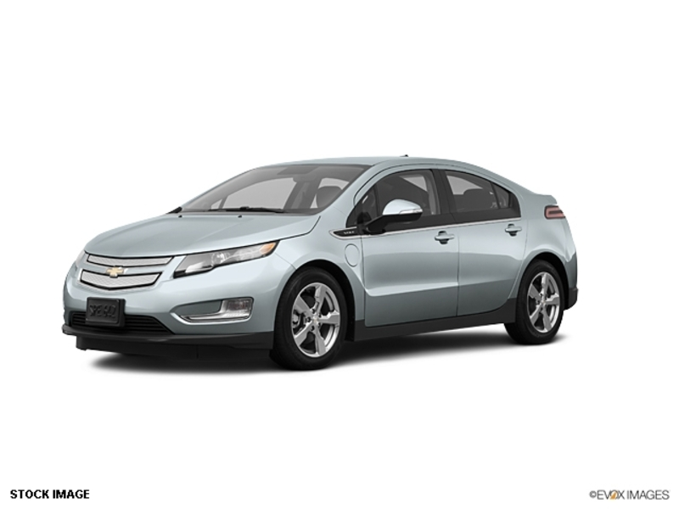
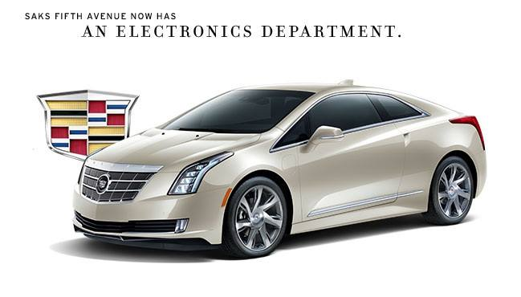
VOLT
CADILLAC-ELR

Slide 31
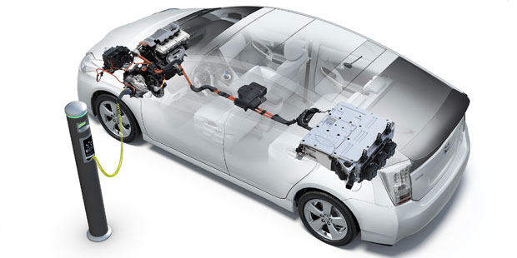
PLUG IN HYBRID VEHICLE

Slide 32


Slide 33

VIDHYADEEP INSTITUTE OF MANAGEMENT & TECHNOLOGY
Electrical Engineering Department
Parth Brahmbhatt
Patel Byushi
Patel Bhavik
Golakiya Nikunj
Patel Sohini
Patel Nikita
Morden Mohommad
Ria Vaidya
Patel jignesh
Patel Richa
special thanks to
Mr chintan dalwadi
(project engineer in GM MOTAR halol)

